Slide 1
Analysis of the Influence of Bandwidth on QoS in IP Networks Using NS-3
Assignment 1:
Name : Rahmat Munir Hasan (M11302828)
Reference :
[1]. ideas and content of research reports from chat-gpt searches
[2]. B. Shin and D. Lee, “An Efficient Local Repair-Based Multi-Constrained Routing for Congestion Control in Wireless Mesh Networks,” Wireless Communications and Mobile Computing, vol. 2018, no. 1, p. 2893494, 2018, doi: 10.1155/2018/2893494.
[3]. G. W. Cermak, “Multimedia Quality as a Function of Bandwidth, Packet Loss, and Latency,” Int J Speech Technol, vol. 8, no. 3, pp. 259–270, Sep. 2005, doi: 10.1007/s10772-006-6368-3.

Slide 2
1. Problem to be solved:
In everyday life, many devices use the network simultaneously, while the network bandwidth capacity is limited. When incoming traffic increases, QoS (network service quality) can decrease.
1.1 How does bandwidth affect throughput, delay, jitter, and packet loss?
1.2 This research was conducted to find parameters and results to determine optimal QoS in various cases with many variations in bandwidth against throughput, delay, jitter, and packet loss.

Slide 3
2. Key challenges:
2.1 Hard difficult to install ns-3 in linux and write code.
2.2 Traffic uses CBR so that it can be analyzed easily.

Slide 4
3. Proposed method:
To create a very optimal quality of service, data on throughput, delay, jitter, packet loss values ​​are needed to be analyzed using graphs and regression (a method of approaching the relationship between 2 close variables), so that the influence of bandwidth can be determined and reduce the shortcomings of the QoS system because the results are not optimal.
3.1 Independent Variable : bandwith → 1 mbps,3 mbps,10mbps,12 mbps,30 mbps
3.2 Dependent Variable : throughput, delay, jitter, and packet loss.

Slide 5
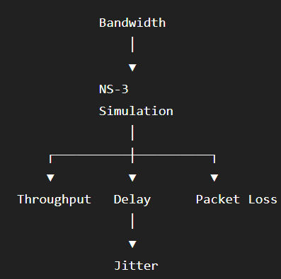
3.3 Algorithm flowchart.
Figure 1, framework for Analysis of the Influence of Bandwidth on QoS in IP Networks.
Figure 1. flowchart simulation system, (Chat-gpt)

Slide 6
3.4 Experiment research.
Set-up Traffic and bandwith as value parameter for input
Skenario | Traffic | Bandwidth
S1 | 10 Mbps | 1 Mbps
S2 | 10 Mbps | 3 Mbps
S3 | 10 Mbps | 10 Mbps
S4 | 10 Mbps | 12 Mbps
S5 | 10 Mbps | 30 Mbps
Table 1. scenario set-up for traffic and bandwidth, (Chat-gpt)
Bandwidth | Throughput | Delay | Jitter | Packet Loss
1 Mbps | ? | ? | ? | ?
3 Mbps | ? | ? | ? | ?
10 Mbps | ? | ? | ? | ?
12 Mbps | ? | ? | ? | ?
30 Mbps | ? | ? | ? | ?
Table 2. measures each parameter Throughput, Delay, Jitter, Packet Loss with various conditions, (Chat-gpt)

Slide 7
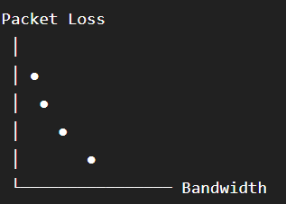
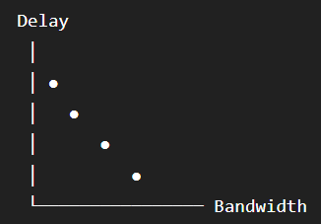
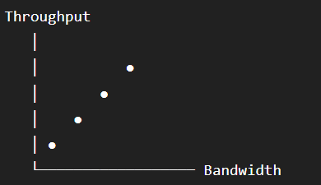
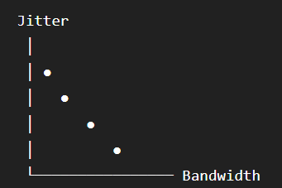
4. Expected outcomes:
Below are the desired results of the research. First, the effect of throughput on bandwidth. Second, the effect of delay on bandwidth. Third, the effect of packet loss on bandwidth. Fourth, the effect of jitter on bandwidth.
Graph 1. collection of research results on the expected equation of 2 variables

Slide 8
A1. Summary How to read
Researchers inevitably spend a lot of time reading scientific research journals. Researchers read journals to teach scientific knowledge from journals, convey it to students in classes or conferences, or to update their own knowledge. Most researchers waste time and effort because they cannot read research journals effectively and efficiently. Postgraduate researchers often use trial and error and waste a lot of time and effort, even feeling frustrated because they do not read research journals. This article overcomes all of these by reading journals using the three-pass method to conduct a literature survey. There are 3 challenges in each step from 1 to 3. The first step challenge is to read slowly for the title,abstract, and introduction and you must be able to answer the 5C parameters to understand. The second step challenge, labeled graphs and incorrect figures can be confusing. The third step challenge requires reading the journal 3 times to understand it. The method proposed for efficient reading is called THE THREE-PASS APPROACH. Generally, you should read a journal three times rather than starting from the beginning and working your way through. The first step gives you a general overview of the journal. The second step gives you a grasp of the journal's content, but not the details. The third step gives you a complete understanding. Reading journals using the THREE-PASS APPROACH method can help you understand journals more efficiently and conduct a literature survey to ensure you understand everything.

